Slide 1
CAR PRICE PREDICTION
Nida Momin (3219066)
Mustansir Sabir (3219068)
Marzook Khatri (3219071)

Slide 2
INTRODUCTION
This project presents a car price prediction system by using the supervised machine learning technique. It focuses on developing machine learning models that can accurately predict the price of a used car based on its features, in order to make informed purchases.
This project has the following goals:
1. Design: The project includes the design of a system explaining linear relationship between X and Y which are price and other factors like model and make of the car.
2. Predict: The project predicts the price of the vehicle using linear regression model which identifies different patterns and projects and predicts the value of the vehicle.
3. Confirm: The project finds out which variable associated with the vehicle is the best predictor of its price.

Slide 3
OBJECTIVE
Our main objective is to predict the prices of the used cars given various attributes.
This will assure the customer whether the prices are exact and correct and are not manipulated by the sellers.
For this purpose we have used machine learning algorithm which makes it easier to analyze the data to track the prices.
This is an excellent way to find the prices for people who prefer to buy cars through lease or second hand.

Slide 4
MODEL SELECTED
Linear regression is one of the most commonly used predictive modeling techniques.
These models can be trained easily and efficiently even on systems with relatively low computational power when compared to other complex algorithms.
Moreover, linear regression fits linearly separable datasets almost perfectly and is often used to find the nature of the relationship between variables.

Slide 5
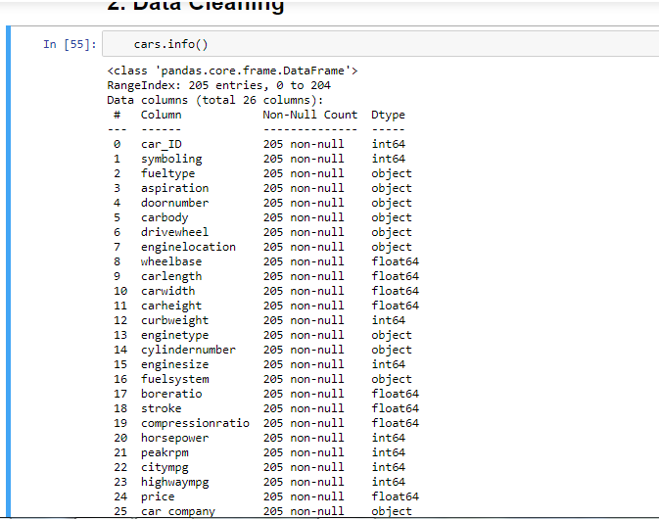
METHODOLOGY
1. DATA EXPLORATION
Analyzing through visual exploration to gather insights about the model that can be applied and the further processes to be performed on the data.

Slide 6
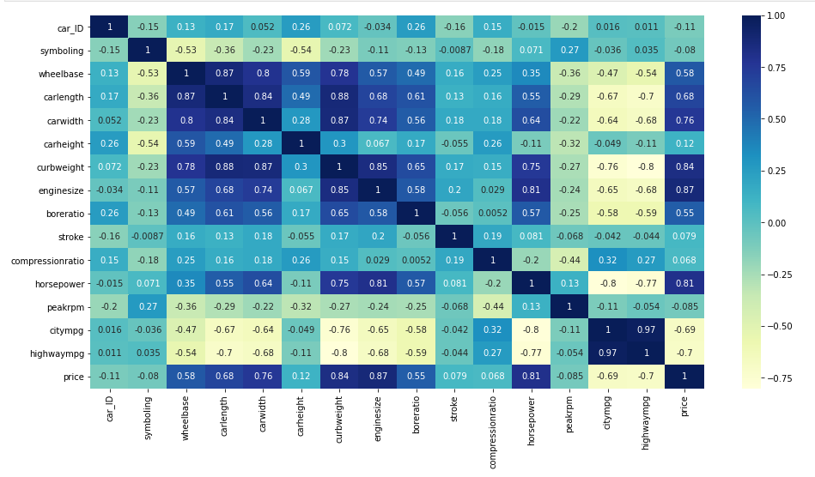
Plotting the Heatmap to visualize the correlation between various attributes.

Slide 7
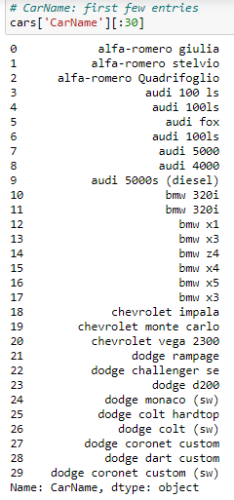
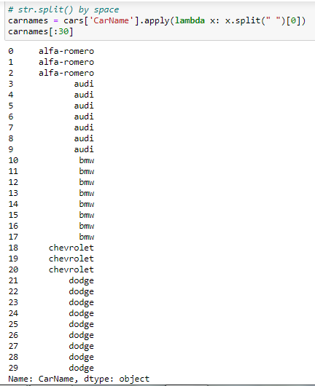
2. DATA CLEANING - Here we split the car name into company name only and remove the model name for better understanding.
Before Cleaning
After Cleaning

Slide 8
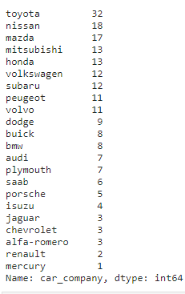
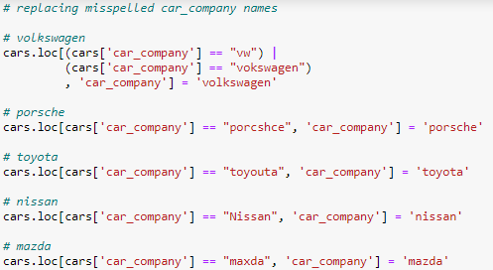
Replacing the misspelled company names.

Slide 9
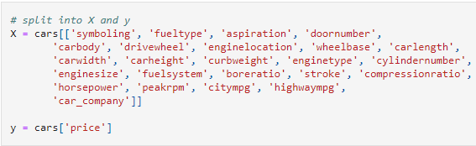
3. DATA PREPARATION
Splitting data into X and Y where X includes all the attributes of dataset except the price and Y includes only the price attribute.

Slide 10
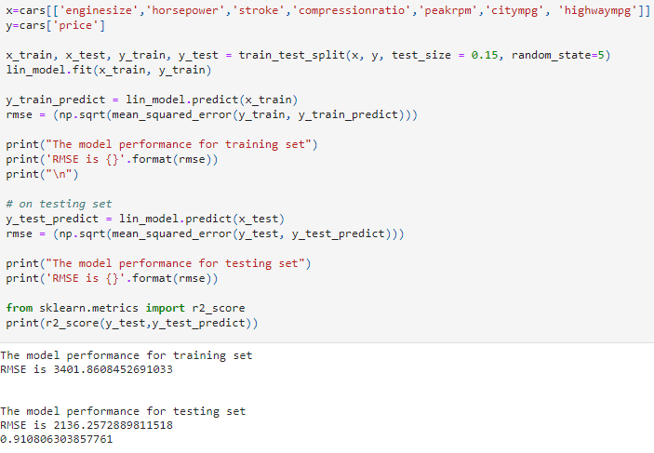
4. Model Building -
Using train and test models to find the RMSE value and accuracy.

Slide 11
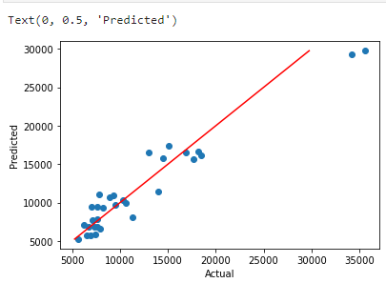
RESULTS Plotting the regression graph to show the actual and predicted values.

Slide 12
THANKYOU

